Slide 1
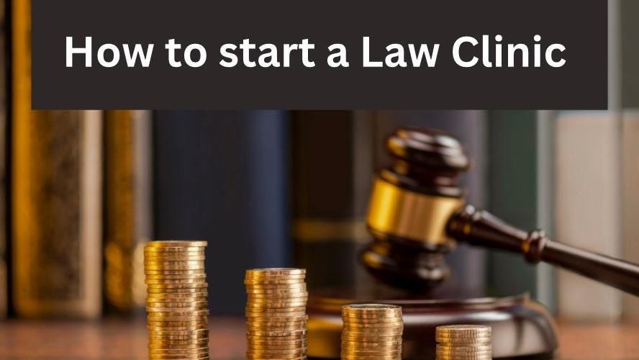
“Be the change you want to see in the world.” Mahatma Gandhi
Presented by Emmie de Kock
On Monday, 6 November 2023

Slide 2
About the presenter
Emmie de Kock
BLC LLB (cum laude) (UP) (1995-1999)
Practised as an attorney in Gauteng for over 15 years
Specialised in IP law, IT law and commercial law matters
Started and operated own law firm for 11 years
Successfully sold own legal practice in 2016
Accredited SA Business Coach and certified NLP Life Coach
Lawyer Coach for over 5 years t/a LawyerFirst
Founder-manager of Lawyers Working Smart launched in May 2020
Married with teenagers!
Director of NPC relating to Christian ministry
Copyright in this presentation belongs to LawyerFirst. This presentation may not be copied, distributed or commercialised, without LawyerFirst written permission.

Slide 3
Content
A “law clinic” is a form of legal practice which may be operated by (a) attorneys/advocates or (b) university law faculties as referred to in Section 34(8) of the Legal Practice Act no 28 of 2014 which provides free legal services relating to limited legal practice areas serving individuals of a specific group of people, a social justice cause, or to the development of the Law.
This presentation will focus on (a) attorneys and advocates interested to start a law clinic (and not (b) law clinics at university law faculties).
Why start a Law Clinic?
What are the LPA requirements?
What are NGOs, NPOs and NPCs?
NPO registration
Apply for tax exemption
What is the business model of a Law Clinic?
Checklist before approaching funders / donors
Steps to start a Law Clinic

Slide 4
1. Why start a Law Clinic?
Many legal practitioners starting or operating sole proprietor legal practices struggle to find paying clients and/or to compete with salaries offered by LegalAid.. Could starting a Law Clinic offer a viable alternative legal practice opportunity for legal practitioners?
There is a high demand for free legal services in South Africa. SA’s current unemployment rate is 32,6%.
Current free legal service providers in terms of the Legal Practice Act 28 of 2014:
- LegalAid (Legal Aid South Africa Act 39 of 2014)
- University Law Clinics (South African University Law Clinics Association)
- Compulsory community service hours by all legal practitioners (From September 2023)
There are many non-government funded charities in South Africa, but very few non-government funded law clinics. Why?
Only admitted legal practitioners can start and operate Law Clinics. An attorney must take initiative. Many lawyers want to service more people BUT perhaps do not know how or think they cannot afford it...
A Law Clinic as legal practice requires a very different approach, legal structure and business model. It requires an open-minded lawyer who is willing to partner with others and provide specific legal services to a specific target market. It also requires a long term plan and commitment.
The business model must ensure good income for lawyers, otherwise lawyers will not commit…

Slide 5
2. What are the LPA requirements?
Section 34(8) provides requirements for a Law Clinic as type of legal practice:
Subject to approval of Council
Must be registered in terms of the NPO Act (voluntary association, charitable trust or NPC) or be part of the Law Faculty at an university. Majority of governing body must be legal practitioners.
Legal services must be rendered by/under supervision of attorney/s.
Law Clinic may not make over, divide or share professional fees with others by way of partnerships, allowances or commissions.
May not distribute any of its income or property to its members, office bearers or employees EXCEPT reasonable compensation (salaries) for services rendered.
May employee candidate attorneys, if complying with all the LPA Rules.
Rules of the Legal Practice Council limit legal services of Law Clinics.
Legal services must be accessible to the public and offered free of charge to recipients EXCEPT any amounts actually disbursed on behalf of recipient may be recovered from the recipient.

Slide 6
Rules of Attorney profession (previously rules of Provincial Law Societies, now adopted by Provincial LPCs)
Extract of rules published in GG on 26 Feb 2016
52.3.2 where the clinic acts for the successful litigant in litigation it will be entitled to take cession from such litigant of any order for costs awarded in favour of the litigant and to recover those costs for its own account;
52.4 the services may be rendered only to persons who, in the opinion of the Council, would not otherwise be able to afford them, or, with the prior written approval of the Council, services rendered in the public interest; and the Council may from time to time issue guidelines for the assistance of clinics in determining to whom services may be rendered;
52.5 the clinic may not undertake work in connection with the administration or liquidation or distribution of the estate of any deceased or insolvent person, mentally ill person or any person under any other legal disability, or the judicial management or the liquidation of a company, nor in relation to the transfer or mortgaging of immovable property, nor in relation to the lodging or processing of claims under the Road Accident Fund Act, 1996, or any amendment thereof, or such other work as the Council may from time to time determine;
52.6 the name under which the clinic is to carry on its activities, and the letterheads and other stationery of the clinic, shall require the prior approval of the Council;
52.8.2 the clinic is open for business during normal business hours for not less than 11 months in any year;
52.8.3 the clinic has proper office systems with telephones, typing facilities, files and filing procedures, a diary system and at least elementary library facilities;
52.8.4 the clinic has a proper accounting system and accounting procedures;

Slide 7
3. What are NGOs, NPOs and NPCs?
No registration required
Not part of government
Activities benefit a group (Eg schools, sport, old age homes etc)
NGO = Non-government organisation
Nonprofit Organisations Act
Requires registration and annual renewal
NPO = Nonprofit organisation
Possible legal structures to afford a NPO contractual capacity
and limit personal liability:
1. Voluntary Association
2. Charitable Trust
3. NPC = Non-profit Company

Slide 8
Legal structures for NPO registration registrtion
Legal structure | Founding documents | Law and office | Nature
Voluntary assosication | Signed and dated Constitution | Common law | Democratic member-based organisation.
Charitable Trust | Trust Deed Letter of Authority | Trust Property Control Act Masters Office | Trustees can make decisions.
Non-profit company (NPC) | Certificate of Incorporation Customised MOI (which complies with SARS requirements for PBO status) | Companies Act CIPC | Option to register with or without members. Without members means small group directors can head NPC.
Registrations provide comfort and assurance to potential donors.
NPO registration means your founding document complies with minimum standards of good governance in terms of the NPO Act.
NPO status requires lodging annual financial and narrative reports to the NPO Directorate.
NPC registration makes the identity of directors immediately identifiable and verifiable online at CIPC.
Legal practitioners and Law Clinic approved by LPC should provide further comfort to donors.
Which legal structure will work best for type of legal services you intend to offer? Which legal structure will donors prefer?

Slide 9
4. NPO Registration
1. Establish legal structure
1. Voluntary association
2. Charitable trust
3. npc
2. Make sure founding document (eg MOI) include provisions which will satisfy requirements of
the NPO ACt.
3. Apply manually or online to The NPO Directorate which falls under the Department if Welfare and Social Development based in Pretoria.
4. It could take 2-3 months to receive your NPO number and further 2-3 months to obtain your certificate
of NPO registration.
5. To maintain your NPO registration status, you must submit annual returns to the NPO Directorate, which include a financial and narrative report.
See examples of annual reports:
https://section27.org.za/

Slide 10
5. Apply to SARS for tax exemption
NPO registration does not automatically provide a tax benefit. NPO must apply to SARS to become tax exempted.
Tax exemption means that if you rely on donor funding, you will not pay any income tax or donation tax.
Re property transactions, no transfer duty or capital gains tax will apply.
Most important: Donors are likely to require tax exemption, ie Section 18A Certificate for tax deduction.
Make formal application to the Tax Exemption Unit (TEU) of SARS based in Pretoria in terms of Income Tax Act. It may take 5-6 months.
In addition, you could consider applying for a PBO registration with SARS if your Law Clinic has the sole objective of providing one or more of the Public Benefit Activities (PBA) prescribed by SARS. A PBO registration also offers income tax exemptions.

Slide 11
6. What is the business model of a Law Clinic?
For profit (commercial) law firm (sole prop / partnership / Inc) | Non-profit Law Clinic
More than 85% of attorney firms are sole proprietors. 100% of advocates are sole proprietors. | Must be at least 3 founding / board / trustee members.
Only legal practitioners can own-operate. | At least one attorney and others. Could include non-legal practitioners. However, majority of governing members must be legal practitioners.
Name must include the surname/s of a legal practitioner/s (unless approved otherwise by the Legal Practice Council) | Name must be approved by Legal Practice Council.
Target market must be able to afford legal services. Some law firms struggle to get paying clients… | Target market must require free legal services. Demand is high! (Use “means test”)
May focus on specialised legal services or offer legal services in all legal practice areas. | May focus on limited or various legal services, but may not offer legal services relating to liquidations, administrations, RAF claims, deceased estates or conveyancing. May also offer non-legal services (eg training or counselling).
Self-funded / personal loans / family support. | Donors, funders, grants and community support. May recover costs, if successful in litigation. May charge disbursements.
No tax exemptions. | Tax exemptions.
Build an asset / own a business. You can sell, merge or transfer your legal practice. If no other provision is made, upon death, LPC curator may take over. | Build a career and legacy. No ownership. Upon winding-up, dissolution or voluntary deregistration, any assets remaining after liabilities have been met, are transferred to another NPO with similar objectives.

Slide 12
Example of a business structure for a Law Clinic:
NPO Legal Structure =
3 directors/trustees/members =
Law Clinic
1. TARGET MARKET
Example: Woman requiring free legal services relating to family law matters in Thembalethu
2. PARTNERS / VOLUNTEERS
Example: Legal practitioners (law firms) wanting assistance to comply with community service requirement.
Counsellors who want to support victims for free.
4. FUNDING
Example: Corporate company wanting to support the target market and/or comply with CSI and/or want to get tax exemption.
3. EMPLOYEES
Examples: Community member to do marketing, champion for the cause assisting to get funding/donors, supervising attorney and candidate attorneys.

Slide 13
Further example how a Law Clinic can work:
2 Attorney firms + 1 Advocate form a NPO legal structure and obtain tax exemption =
Legal Clinic
Present business plan and secure funding/donations to pay for Law Clinic office, support staff, marketing and the salaries for the operating legal practitioners
Legal Clinic submit annual returns (financial and narrative reports)
Secure clients and legal practitioners provide free legal services to target market
Should it be possible to be an office bearer or volunteer partner to a Law Clinic parallel to owning/operating your own commercial (for profit) attorney / advocate legal practice? Yes. What may be possible concerns or benefits?

Slide 14
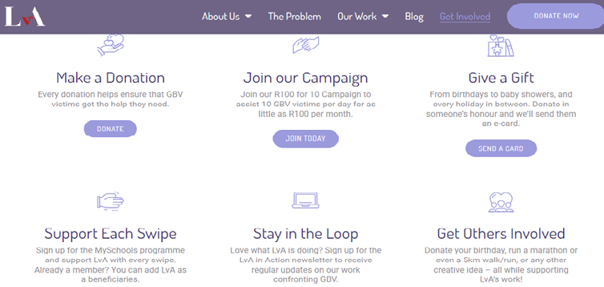
7. Checklist before approaching funder/donor:
Do you have a team headed by at least one attorney?
Are your registrations, bank account and tax exemption in order?
Do you have a business plan? (Target market? Services in demand? Marketing plan? Operations plan? Systems? Staff plan? Premises? etc)
Do you know how much money you will need? (Budget? Expenses? Salaries?)
Who could be likely donors or funders for the Law Clinic? Who wants to help your target market?
Examples what funding could be for: Ideas to get funding: - Employee salaries - Fundraiser events - Legal structure administration - Ask private / angel investors - NPO registration - Apply for government grants - Accountant - Ask foreign donations - Branding and marketing - Ask corporates who want to - Systems and computers boost their CSI - Office rent (Corporate Social Investment)
Example: See Lawyers Against Abuse website

Slide 15
Examples of funders: Lawyers for Human Rights

Slide 16
Example: Donors for ProBono.org

Slide 17
8. Steps to start a Law Clinic
1. Get minimum 3 people involved (one must be a SA attorney and no more than 2 people can be related)
2. Develop a business plan for a Law Clinic (legal practice)
3. Determine your budget and how much funding you will need
4. Decide your name and form/register your preferred legal structure (eg voluntary association, charitable trust or NPC)
5. Obtain NPO registration
6. Apply to the Legal Practice Council for approval
7. Open a bank account
8. Apply to SARS for tax exemption
9. Secure funding
10. Secure clients

Slide 18
Thank you for attending
Was this helpful?
What is your next step?
If you are interested in one-on-one business coaching with me, you are welcome to connect with me:
Email: emmie@lawyerfirst.co.za
Cell no: 082 704 1774
Copyright notice: Copyright in this presentation belongs to LawyerFirst. This presentation may not be copied, distributed or commercialised, without LawyerFirst written permission.

Slide 19
You are invited to enter FREE on our website:
https://lawyersworkingsmart.co.za/2023/11/01/most-inspiring-sa-law-firm-2023/
Entries close 8 December 2023
Sponsored by: Emmie de Kock t/a

